Slide 1
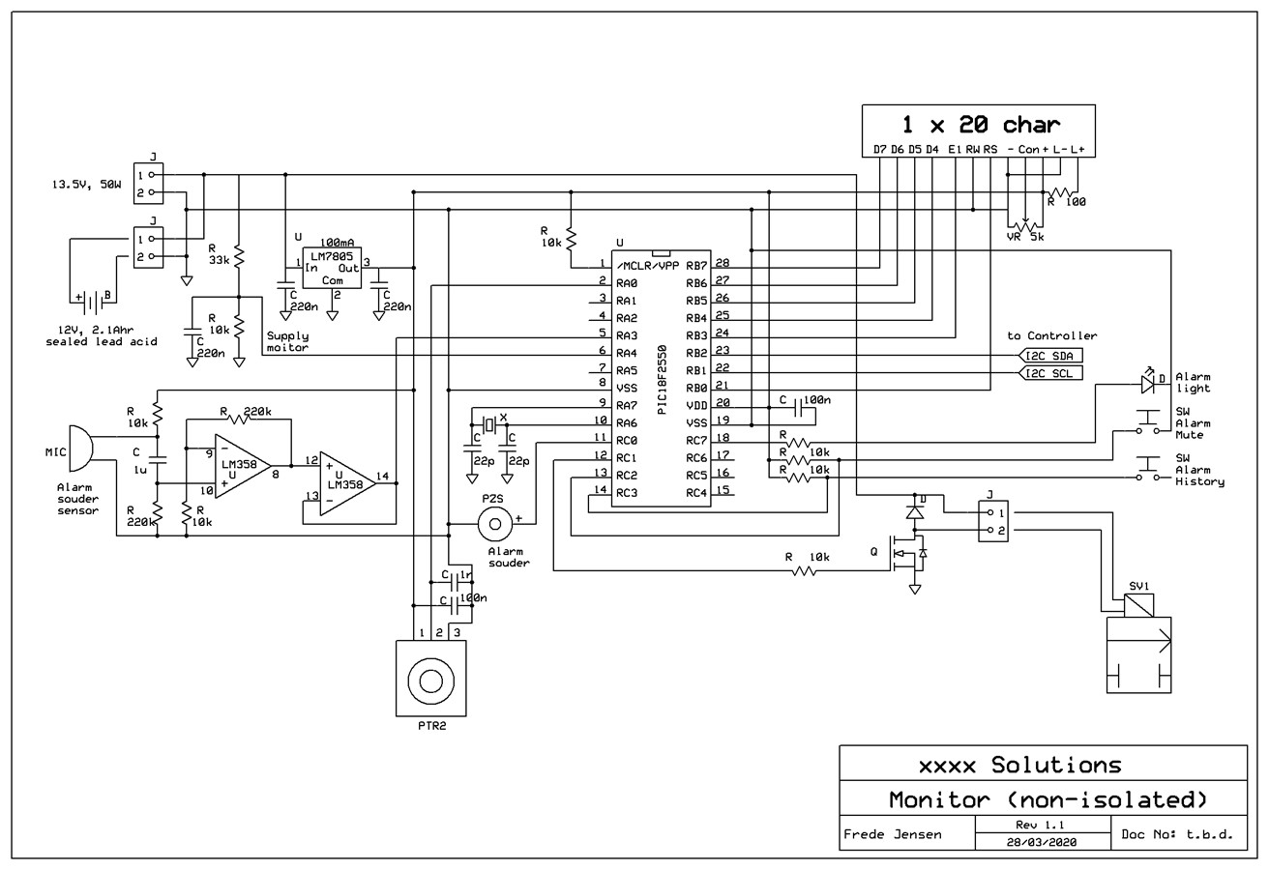
Monitor circuit diagram:
Added power voltage monitor:
< 13v = PSU disconnected (low priority alarm)
< 11.7v = battery low (medium priority alarm)
< 11.3v = safety shutdown in 3 min (high priority alarm)
Change to 5v MPU. The initially suggested PIC model operates on 1.8v to 3.6v, which is incompatible with most LCDs.
Increased FET gate resistor to 10k. This slightly slows the FET switching time (without out causing heating) and better isolates/protects the MPU from the higher power circuit.
Changed LCD to 20 characters, to display a tidal volume value.

Slide 2
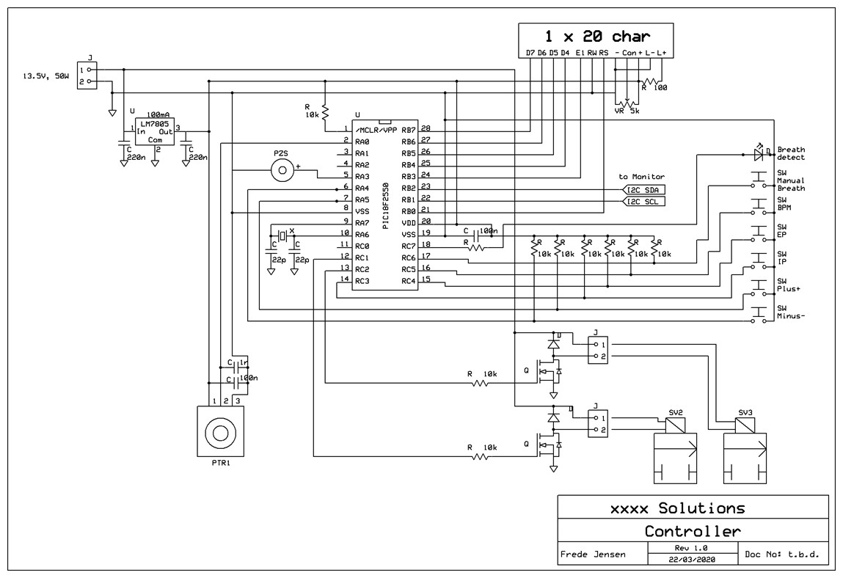
Controller circuit diagram:
Change to 5v MPU. The initially suggested PIC model operates on 1.8v to 3.6v, which is incompatible with most LCDs.
Increased FET gate resistors to 10k. This slightly slows the FET switching time (without out causing heating) and better isolates/protects the MPU from the higher power circuit.
Changed LCD to 20 characters, to match the Monitor unit and leave opportunity for introducing a Minute Volume parameter.

